Slide 1
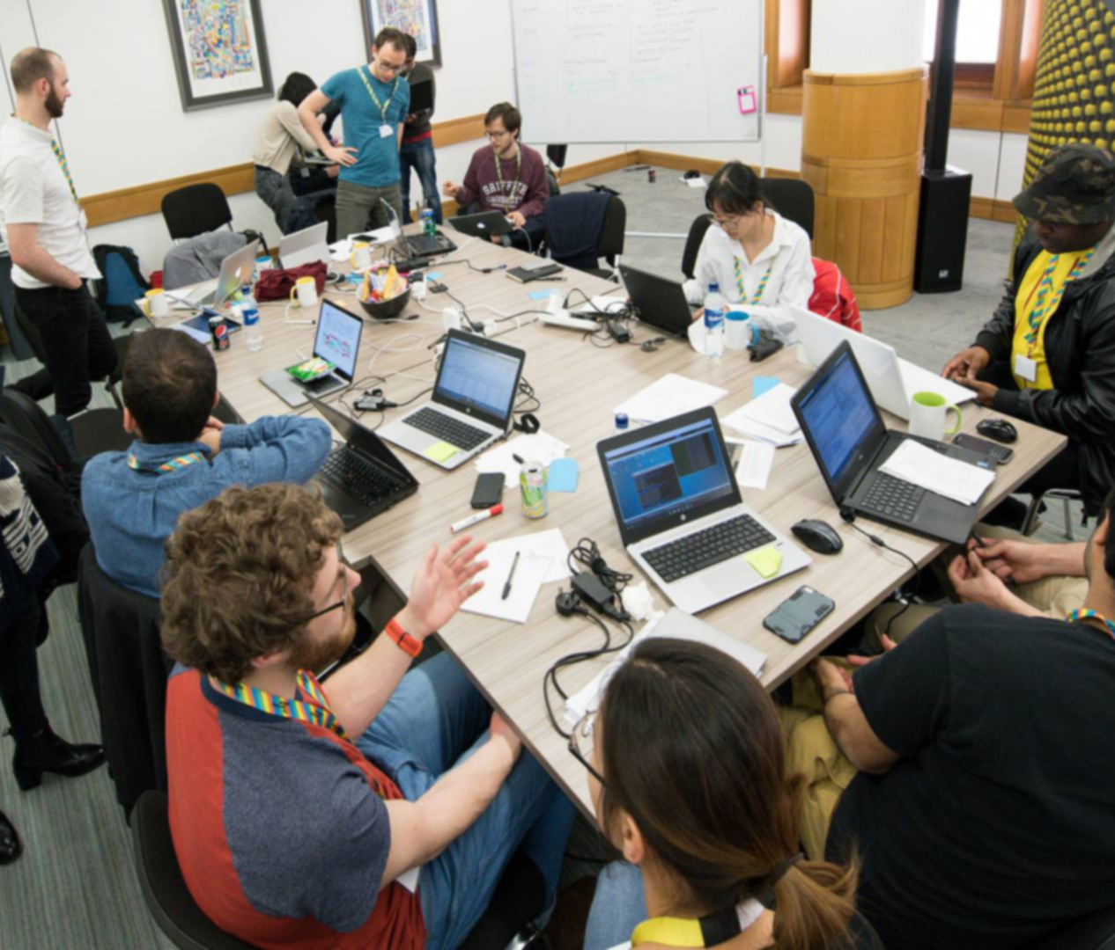
Data Study Groups
Collaborative Knowledge Transfer

Slide 2

What is a Data Study Group?
  Data Study Groups are a Turing-hosted venue for researchers from a broad range of fields to apply their knowledge to new problems posed by industry, government, and civil society groups.
  DSGs are:
  Knowledge transfer both ways between academia and the rest of society
  Collaborative problem-solving events with real outcomes
  Scoped for maximum impact with minimal resource investment
  Supported by the Turing Institute Applied Skills programme as well as partner institutions

Slide 3

Transferring knowledge, driving research
  What kinds of problems are we interested in taking on as part of the Applied Skills programme?
  Our challenges:
  Focus on driving real beneficial outcomes
  Promote learning and continuing research for both the challenge owner and participants
  Demonstrate solid scientific grounding as well as scope for novel solutions
  Allow us to bring together a diverse group of participants and organisers

Slide 4

Horizontal and peer-to-peer learning
  We believe the best kinds of outcomes for our participants and challenge owners come when we allow solutions and innovation to arise organically as part of a group effort.
  To that end, we have designed a structured working framework which shares the best practices of academic research and responsible management, while giving our researchers the flexibility to organise themselves relatively autonomously.
  Instead of imposing our own vision, we provide a safe environment and the tools our participants need to succeed.

Slide 5

Have a challenge in mind or interested in joining a DSG?
turing.ac.uk/collaborate-turing/data-study-groups
@turinginst
skills@turing.ac.uk

