Slide 1
Taming Pandas & Tidy Parsnips
Teaching foundational data skills as part of an innovation curriculum
Graham Cole
Lecturer in Enterprise | Newcastle University

Slide 2
Who is this chap and what does he want?
Data Insights Bootcamp
Two-week, extra-curricular block delivery
40 non-cognate students working in teams of 5
4 Industry partners, 10hrs of contact time
Real-world challenges faced by businesses
Production datasets
8 Minute presentation
Executive Report
Graham Cole
Lecturer in Enterprise | Newcastle University

Slide 3
Innovation is a journey not a destination
Exploring the problem space
The foundation of an effective solution is a deep understanding of the problem.
People
Process
Problem
Data
https://www.nasa.gov/multimedia/imagegallery/image_feature_693.html

Slide 4
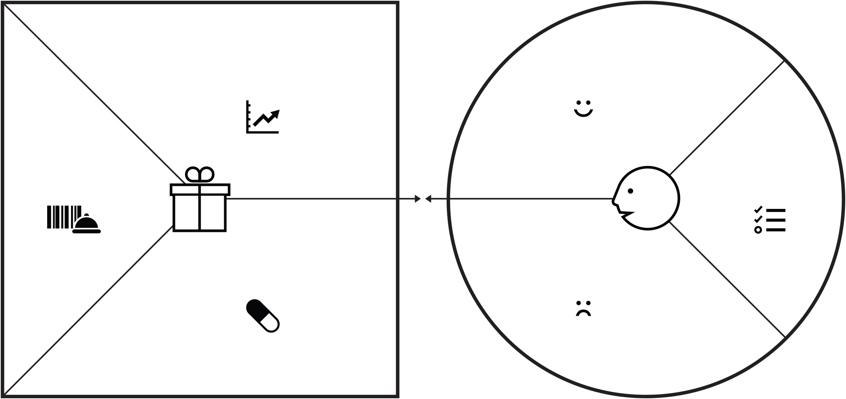
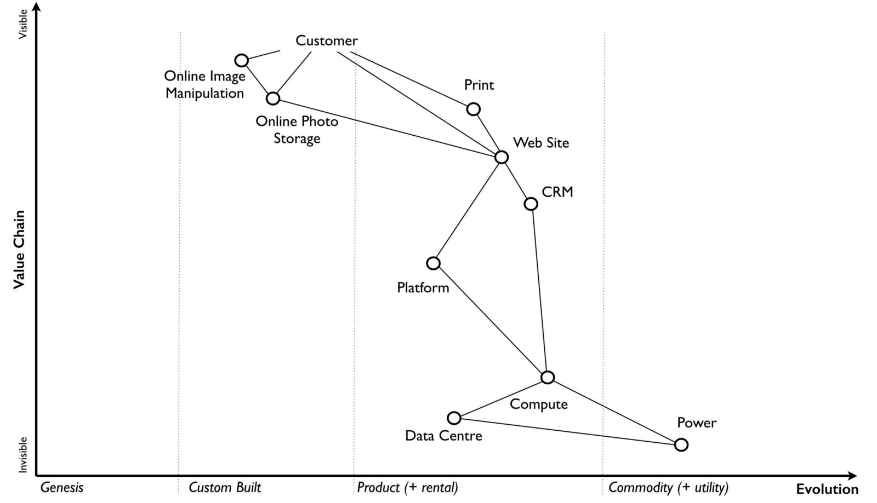
Innovation is a journey not a destination
Designing Value
Customer specificity leads to solutions that achieve product-market fit
Ideate
Fit
Describe
https://www.nasa.gov/multimedia/imagegallery/image_feature_693.html

Slide 5
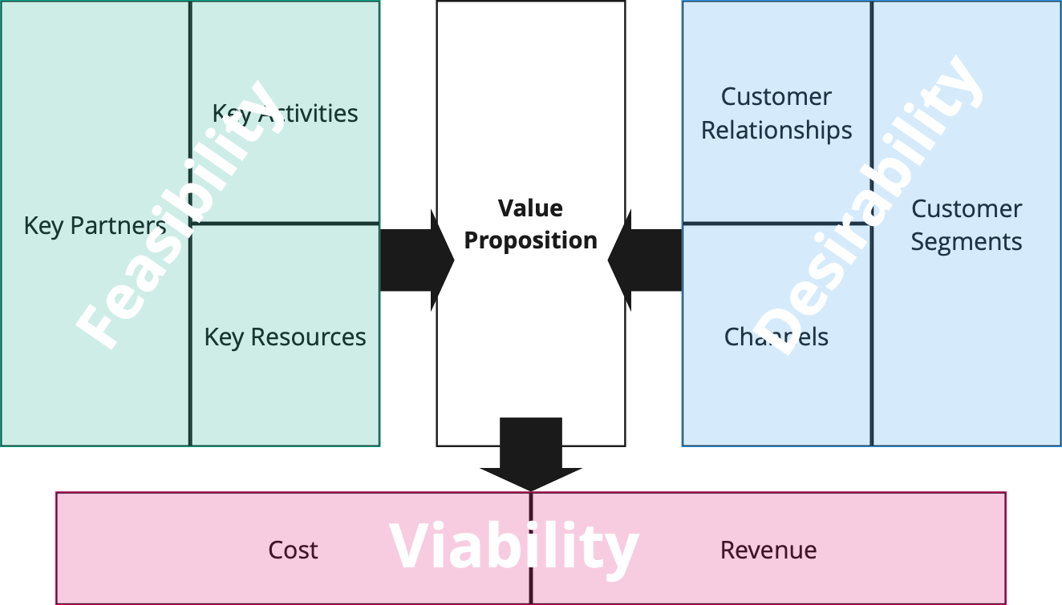
Innovation is a journey not a destination
Building the solution
New products and services require new ways of working and must provide a net value
https://www.nasa.gov/multimedia/imagegallery/image_feature_693.html

Slide 6
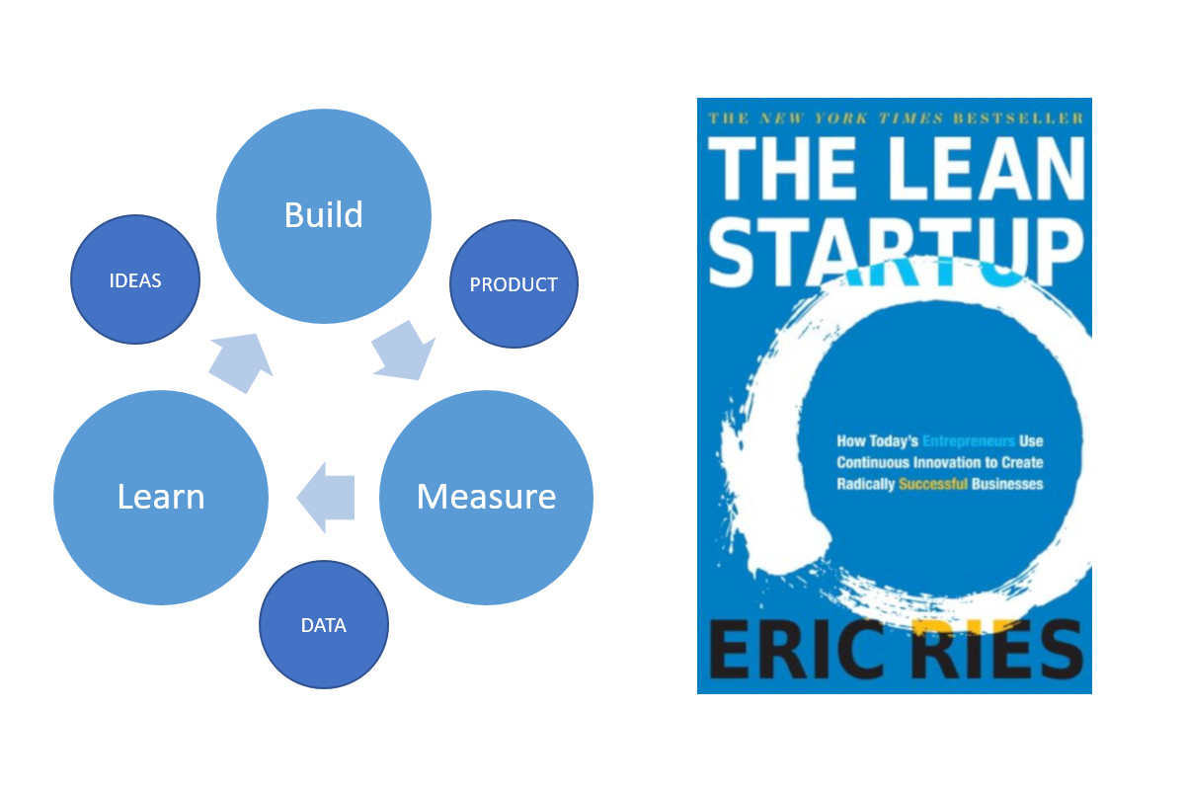
Innovation is a journey not a destination
Making the change
Changes are built upon assumptions until they are tested
Adopting a Minimum Viable Product approach promotes Build-Measure-Learn and failing fast.
https://www.nasa.gov/multimedia/imagegallery/image_feature_693.html

Slide 7
Data to insight in 2 days
Industry Partners provide data related to their challenge
Pre-work carried out by NICD Data Scientists
Focus on ingesting, appraising and communicating value from data within the context of the industry challenge
Orientation lecture covering key aspects of working with Pandas, Matplotlib and Seaborn
Jupyter environment within Azure, pre-loaded data and walkthrough scripts
Output of analysis incorporated into wider innovation narrative
Graham Cole
Lecturer in Enterprise | Newcastle University

Slide 8
Future work
Threshold concepts in foundational data skills
Microsoft PowerApps for modular curriculum
Graham Cole
Lecturer in Enterprise | Newcastle University

